Slide 1


Slide 2
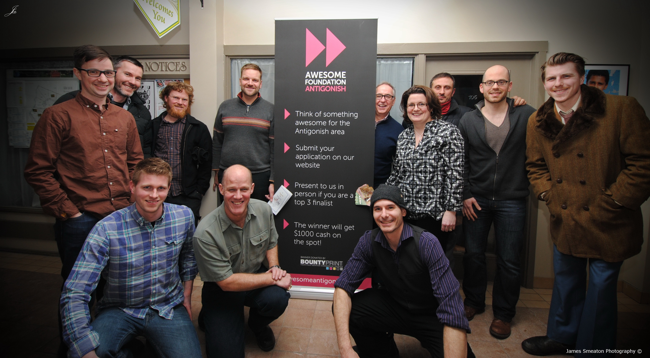

Slide 3
What Is Awesome Antigonish?
Simple
No Strings Attached
Funded by members
Micro-grants for Flashes of Micro-brilliance

Slide 4
Who Is Awesome Antigonish?
Inspired Community Members
All manner of professionals: Doctors, Professors, Business Owners, and Leaders.
People Who Want To See Positive Change

Slide 5
Our Past Winners
Get The Town Growing
Frig Off Get Fit
Youth Activism Conference
A Playground For Every Body
Antigonish Community Video
No Need To Blow The Budget

