Slide 1
THE AWESOME
FOUNDATION
8
(the gateway drug of philanthropy)
Notes:
For those of you who aren’t familiar, the Awesome Foundation is an unofficial organization (not a registered 501c3) that gives a $1000 grant to a different project every month. It’s basically guerrilla philanthropy.

Slide 2

Notes:
Here’s how it works. Applications are due by the end of the month, every month. Our 10 trustees read all the applications, marking the ones they like as “awesome” and creating a shortlist of projects. On the second Tuesday of the month we get everyone in the same room and talk about which projects we liked best and why.

Slide 3

Notes:
Oh yeah, and that $1000? It doesn’t come from a trust fund or an endowment or corporate partner. It actually comes from our pockets.

Slide 4
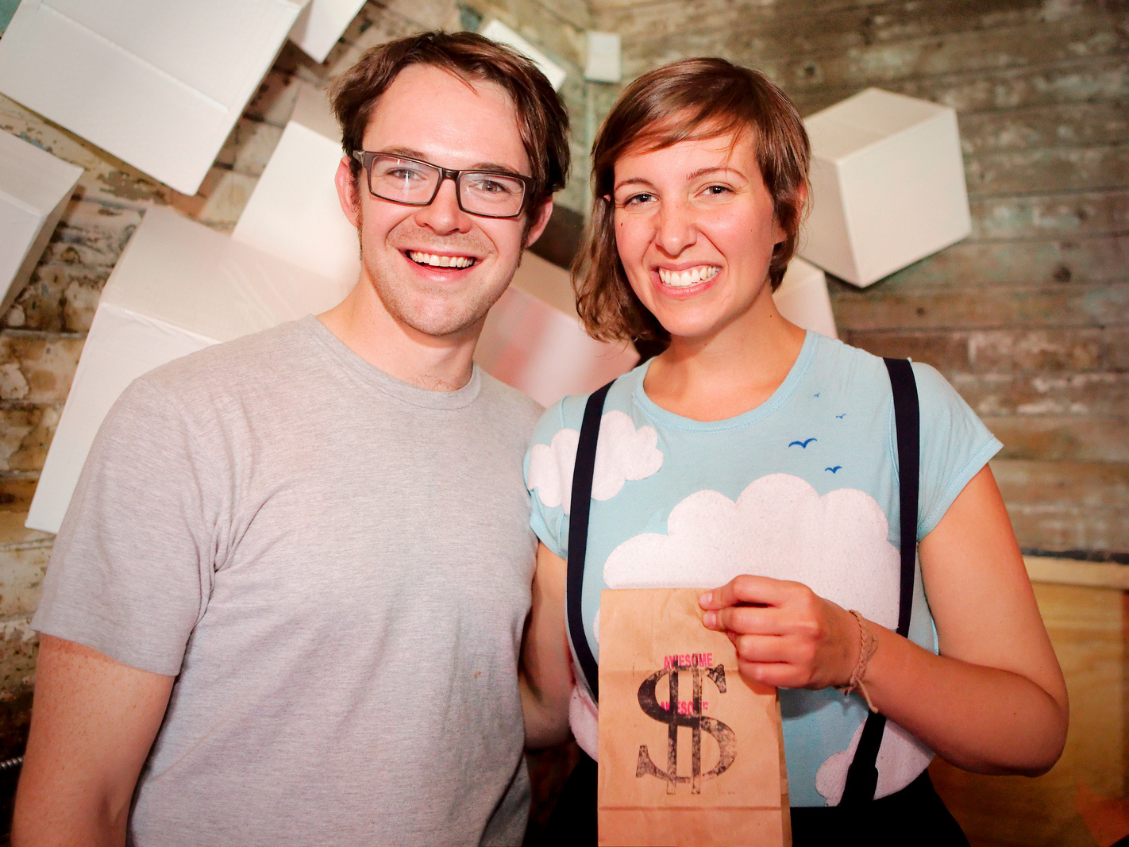
Reg Tianha, AF YYC
Notes:
Once we’ve settled on a project we pick one trustee to be our storyteller. That person contacts the winner, sets up a time they can meet the rest of the group, and gives them a bag of cash.

Slide 5
FAQs
Wait, the Awesome Foundation is a real thing? I thought you were joking.
Notes:
When we tell people about the Awesome Foundation, a lot of the same questions tend to come up…

Slide 6
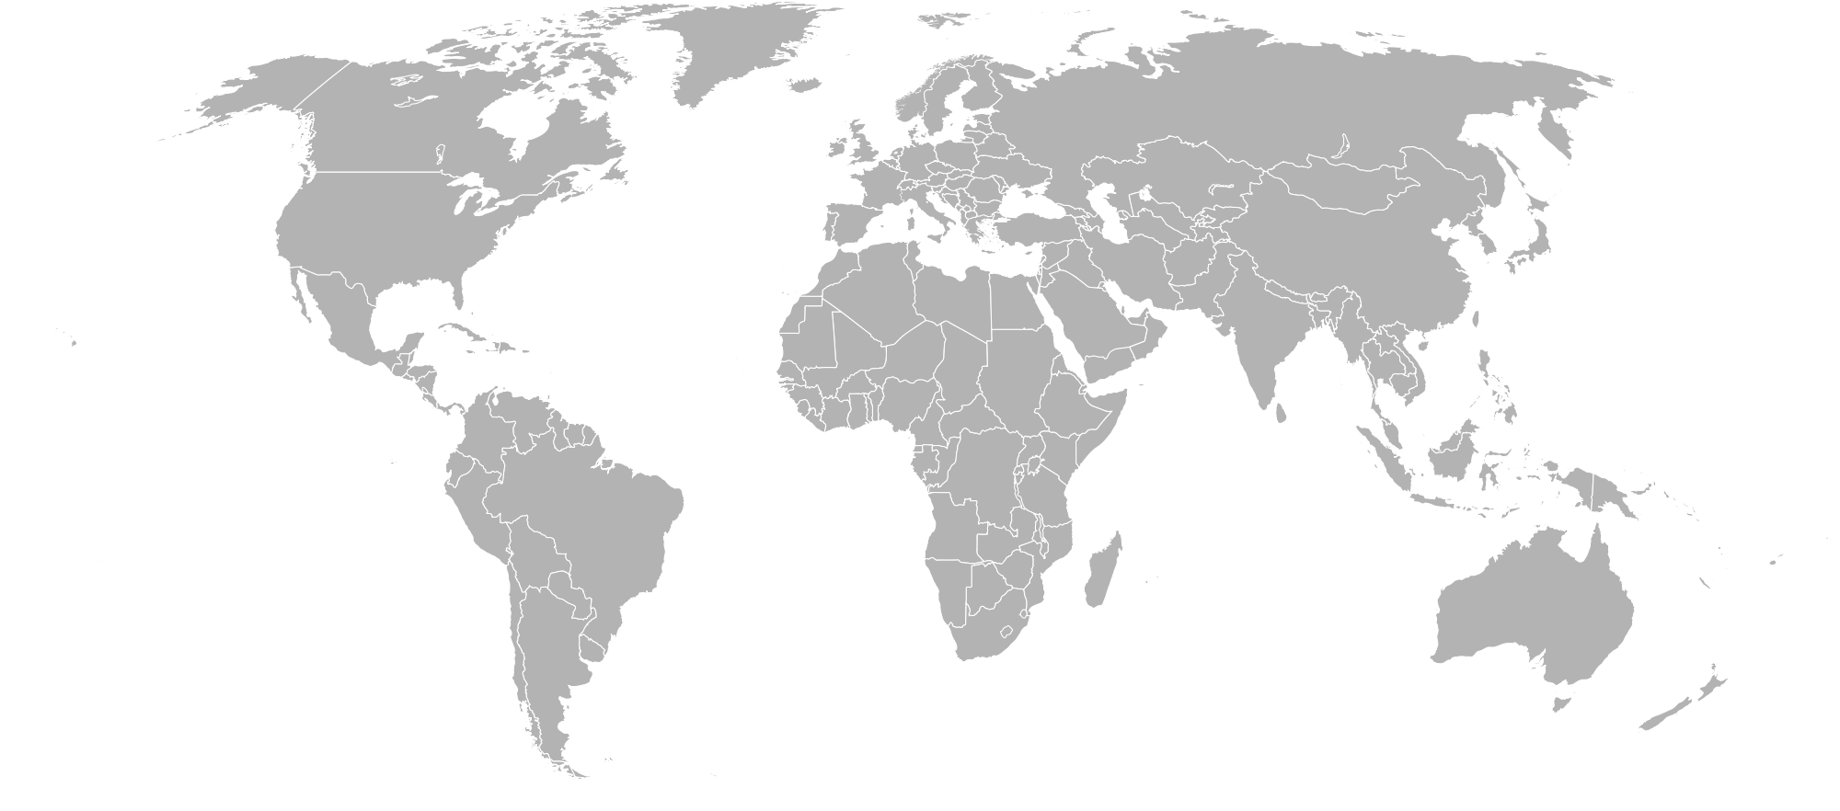

Notes:
It turns out the Awesome Foundation is a real thing… To the tune of more than 60 chapters in 11 countries across 5 continents. Together we’ve supported more than 400 projects and given away over $400,000 just out of our own pockets. In fact, if we keep growing at our current rate we’ll have given away more than $1M by the end of this year. And that’s awesome.

Slide 7
FAQs
What kinds of projects do you fund?
Notes:
Once we’ve convinced people that we really do this, they usually want to know what we fund. Some of them want a better understanding of what we do. Others are already starting to think of ideas and want to know if we might fund them.

Slide 8
Possible
Not incremental
Local
Community building
Run by individuals
Awesome.
Notes:
We really like projects that are…
Possible – we want to know that you can achieve what you’re trying to do.
Not incremental – as much as we appreciate the value of keeping a good thing going, we want to help new ideas take off.
Local – we want to fund things that affect the Seattle area, especially since there are so many chapters all over the world.
Community building – similarly, we really like projects that build a sense of community.
Run by individuals – there are lots of funding channels for established organizations, and we prefer to fund people and small groups, not established orgs.
Awesome – at the end of the day, we’ll throw out all of our previous criteria for anything that makes us say “wow… that’s AWESOME”

Slide 9
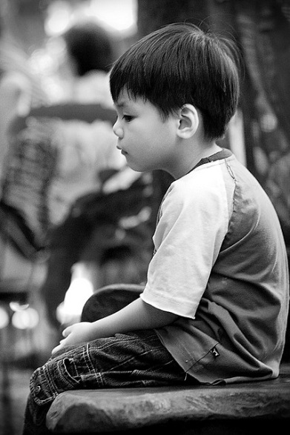
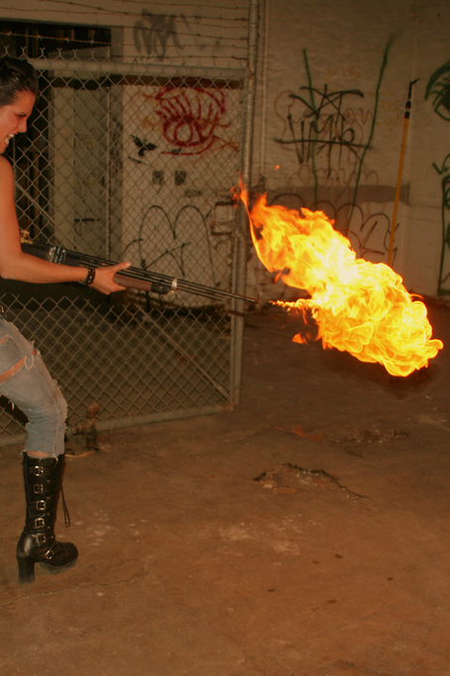
VS
LightChaser@Flickr
slworking2@Flickr
Notes:
We evaluate projects on what we like to call the “orphans vs. flamethrowers” scale.
No, not that kind of orphans vs. flamethrowers…

Slide 10
governance
training
governance
training
portable
dodgeball
meat-filled
piñatas
meat-filled
piñatas
orphans
flamethrowers
Notes:
The idea is to balance primarily philanthropic actions (for example, governance training for citizens in a small Australian town) with quirky, fun, crazy ideas that probably wouldn’t get funded elsewhere (like meat filled zebra pinatas for lions at the zoo). Here in Seattle we’re kind of in the middle – like a portable dodgeball court that promotes exercise (orphans) and is dodgeball (flamethrowers).

Slide 11
FAQs
What’s been funded in Seattle?
Notes:
In Seattle we’ve funded 16 projects – let’s talk in more detail about 3 of them…

Slide 12
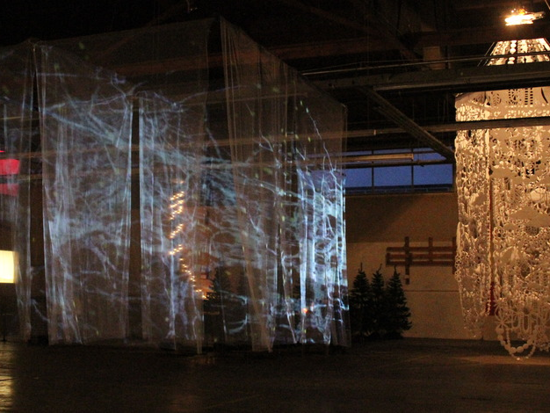
ONN/OF onnof.us
Notes:
ONN/OF was one of our earliest grants. 2 artists came to us with the idea to hold a light festival to combat how depressing and SAD-inducing winter in Seattle is. This project stood out because it was very Seattle-specific, interesting and unique, and trying to do something good for people. It impacted a lot of people – the 3 organizers, the 24 participating artists, and the hundreds of people who went to see it. Even better, it’s still going without our support.

Slide 13
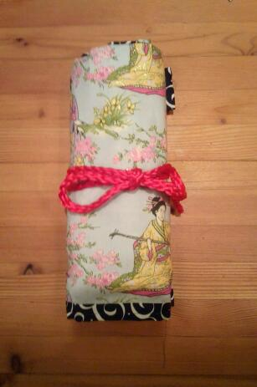
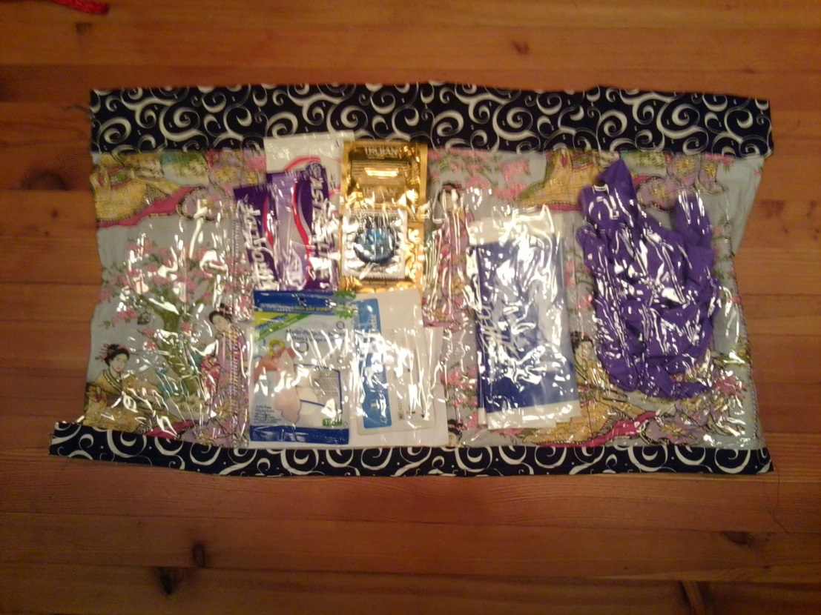
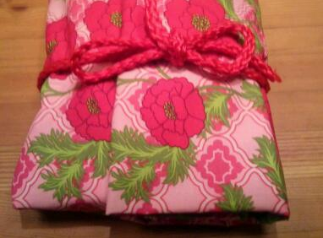
Safe Sex Kits (for homeless teens)
Notes:
This project is more on orphans side. A local crisis center was doing sex education with homeless teenagers, and they ran into 2 problems: first, it was a bit awkward and embarrassing for the teenagers, and second it was hard for them to keep track of materials due to their unstable living situation. The cool thing about this projects was that the idea came from teenager in the class – we wanted to fund it because great example of working WITH teens to help them solve their own problems.

Slide 14
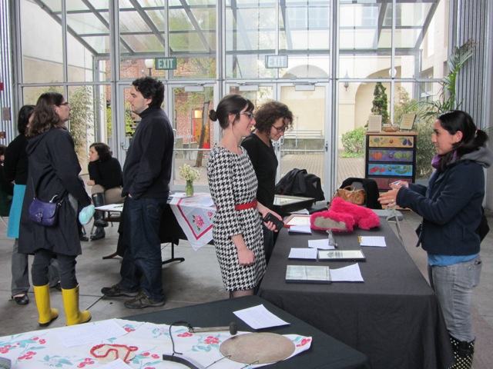
Pop-Up Museum popupmuseum.blogspot.com
Notes:
Let’s change gears and talk about museums. Think of going to an art museum – you look but don’t touch, are watched by security guards, can’t talk loudly, and don’t meet people. We didn’t think about this until Michelle applied for a grant. She had just finished her MS in Museology (science of museums) and was frustrated with how non-participatory museums are. She started the pop-up museum: pick a theme, get everyone to bring an item related to the theme, and hold a museum of those artifacts where people talk to each other about the exhibits. We liked it because it was inclusive, community-centric, and engaging.

Slide 15
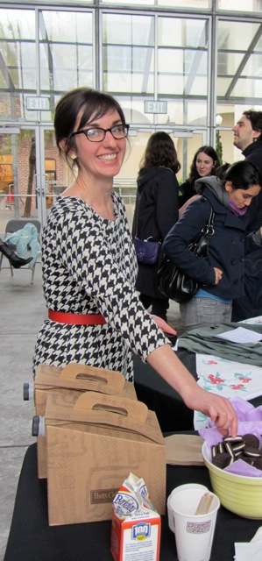
“It was just me before the Awesome Foundation, and after the Awesome Foundation [my project] moved to a bigger scale.”
Notes:
When we checked in with her 6 months later, she said this to us [read quote]. Here’s what she meant: when we first met her she was holding pop-up museums with her friends, family, and colleagues in free public spaces. Since then she has gotten a $200k grant in collaboration with another museum to make pop-up museum kits. She’s also in DC now working at the Smithsonian Institute’s innovation lab. And she’s going to hold a pop-up museum there.
The impact that we have isn’t measured just in dollars – sometimes it helps more to hear someone else say “what you’re doing is awesome”… and then put their money where their mouth is.

Slide 16
FAQs
Who does this?
Notes:
For starters, we do this!

Slide 17
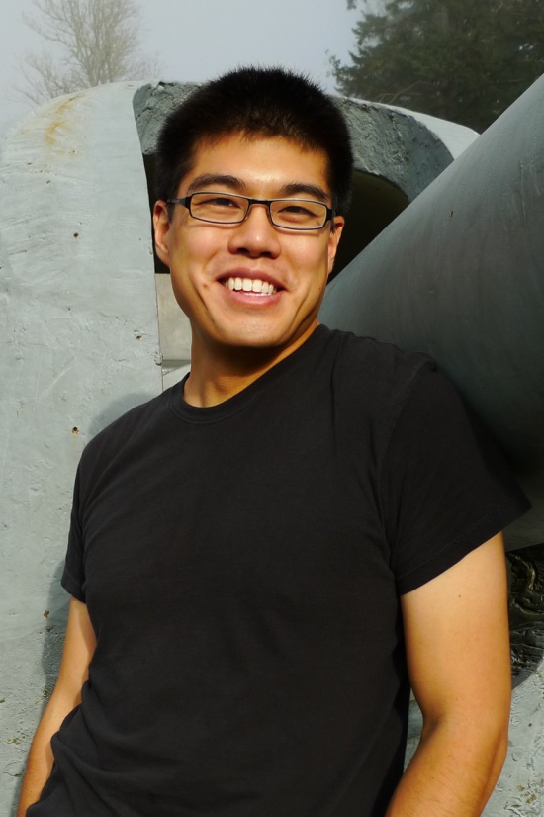
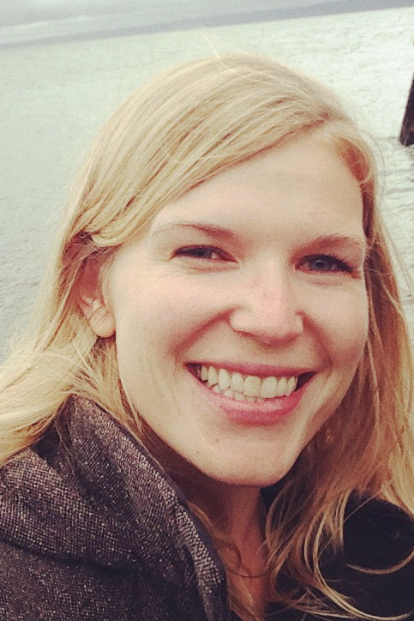
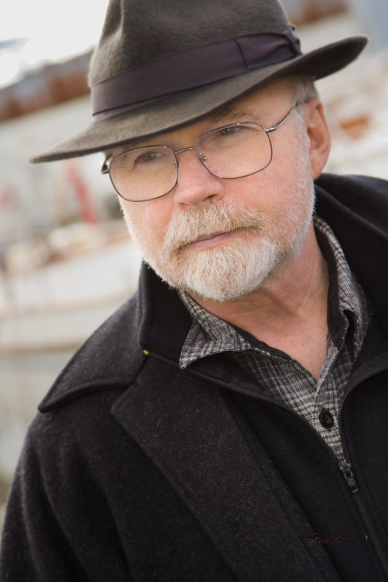
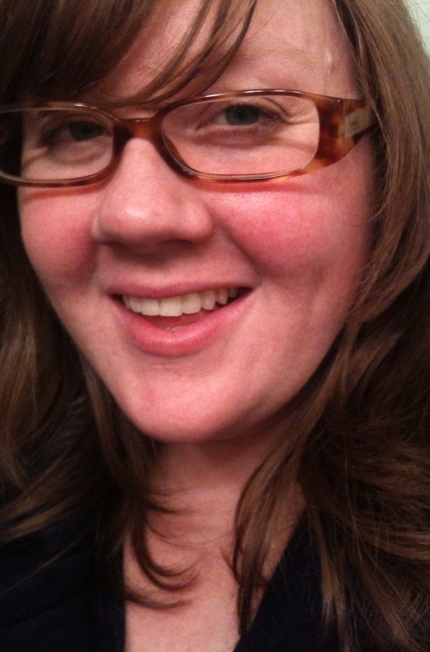
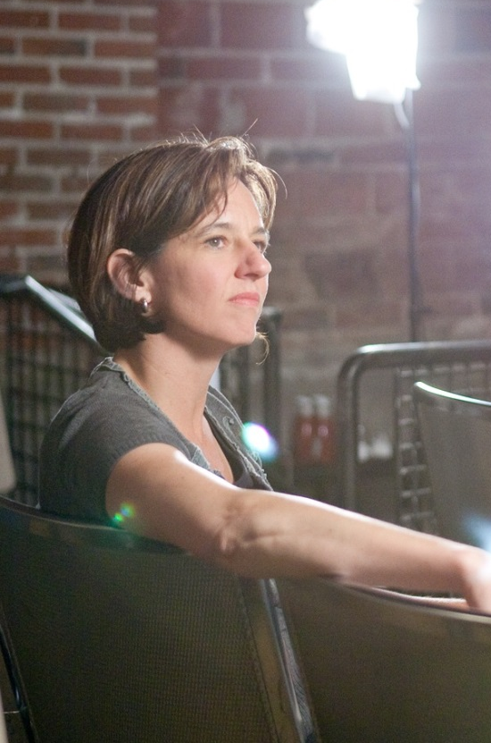
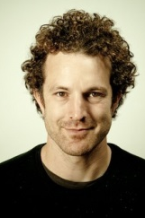
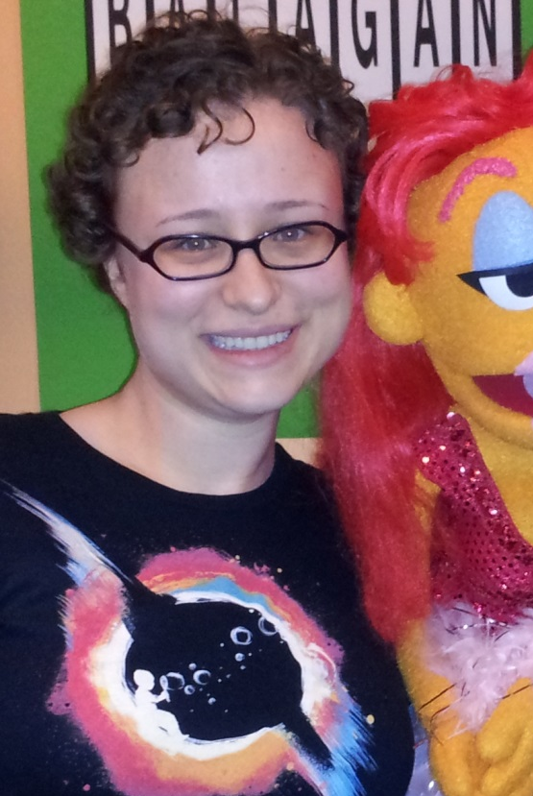
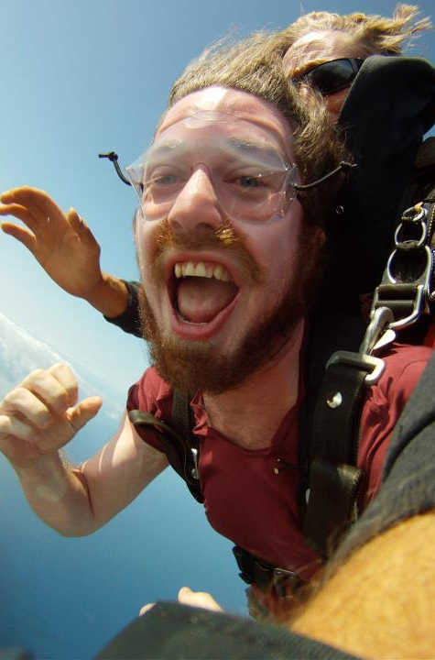
Notes:
We aren’t the only ones, though. These are 8 of the 34 different people who’ve been involved in the Seattle chapter in the last 1 ½ years. We have people from all sorts of fields – technology, film, veterinary medicine… People also get involved for lots of different reasons. Some want to do good in a different way, some want to support local projects, others want to connect to the Global Awesome community, some want exposure to other fields (not JUST tech, not JUST art, etc.)…

Slide 18
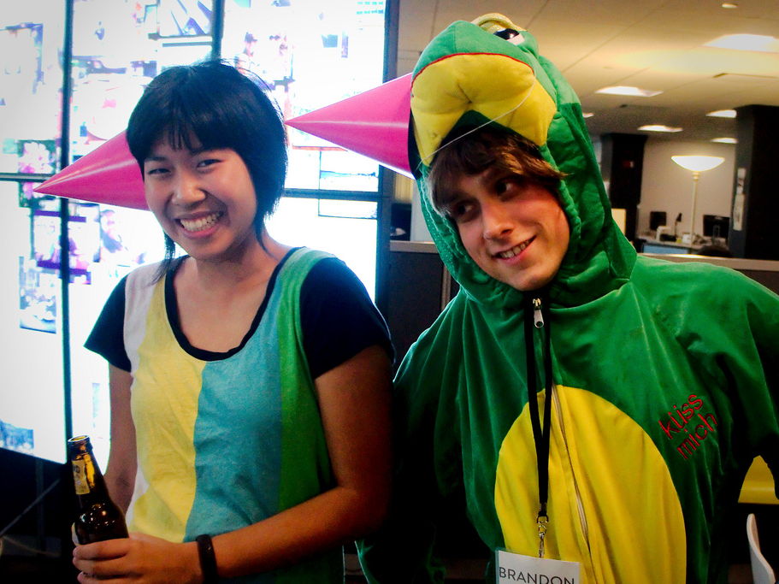
Reg Tianha, AF YYC
Notes:
Plus, it’s fun! Where else can you wear pink party hats and dinosaur costumes while celebrating the 3rd birthday of a foundation?
In fact, one of the biggest things about the Awesome Foundation is that it’s fun. It makes giving money away enjoyable and approachabel… And that’s why it’s the gateway drug to philanthropy. You don’t have to be a billionaire to be a philanthropist.

Slide 19
FAQs
I’m sold! How can I get involved?
Notes:
Hopefully at this point we’ve convinced you to get involved.

Slide 20
1. Party with us. Come to events!
2. Spread the word.
3. Be a guest trustee.
4. Be a full-time trustee.
5. Do a project!
Notes:
1. Come to our events! In addition to having parties, we also hold Awesome Hours every month where people can meet us and go over grant ideas.
2. Spread the word. At the end of the day, we’re a bunch of good-natured, fun-loving people who want to give away thousands of dollars to strangers. The more people who’ve heard of us, the more easily we can do that.
3. If you’re curious about the other side of the table, join us as a guest trustee. It’s a one-time, $100 commitment.
4. If you’re more sure, you can join us as a full-time trustee right away. That means supporting projects every month, and getting to help pick every month.
5. Finally, and most importantly, you can do a project! We’re nothing without projects to fund.

Slide 21
4
8
:
@AwesomeSeattle awesomeseattle.org
@ellenchisa and @nkkl
Notes:
Hopefully by now we’ve convinced you to get involved with the Awesome Foundation. Even if we haven’t, we like to think that we’ve shown how a small amount of money can make a big difference.

